Slide 1
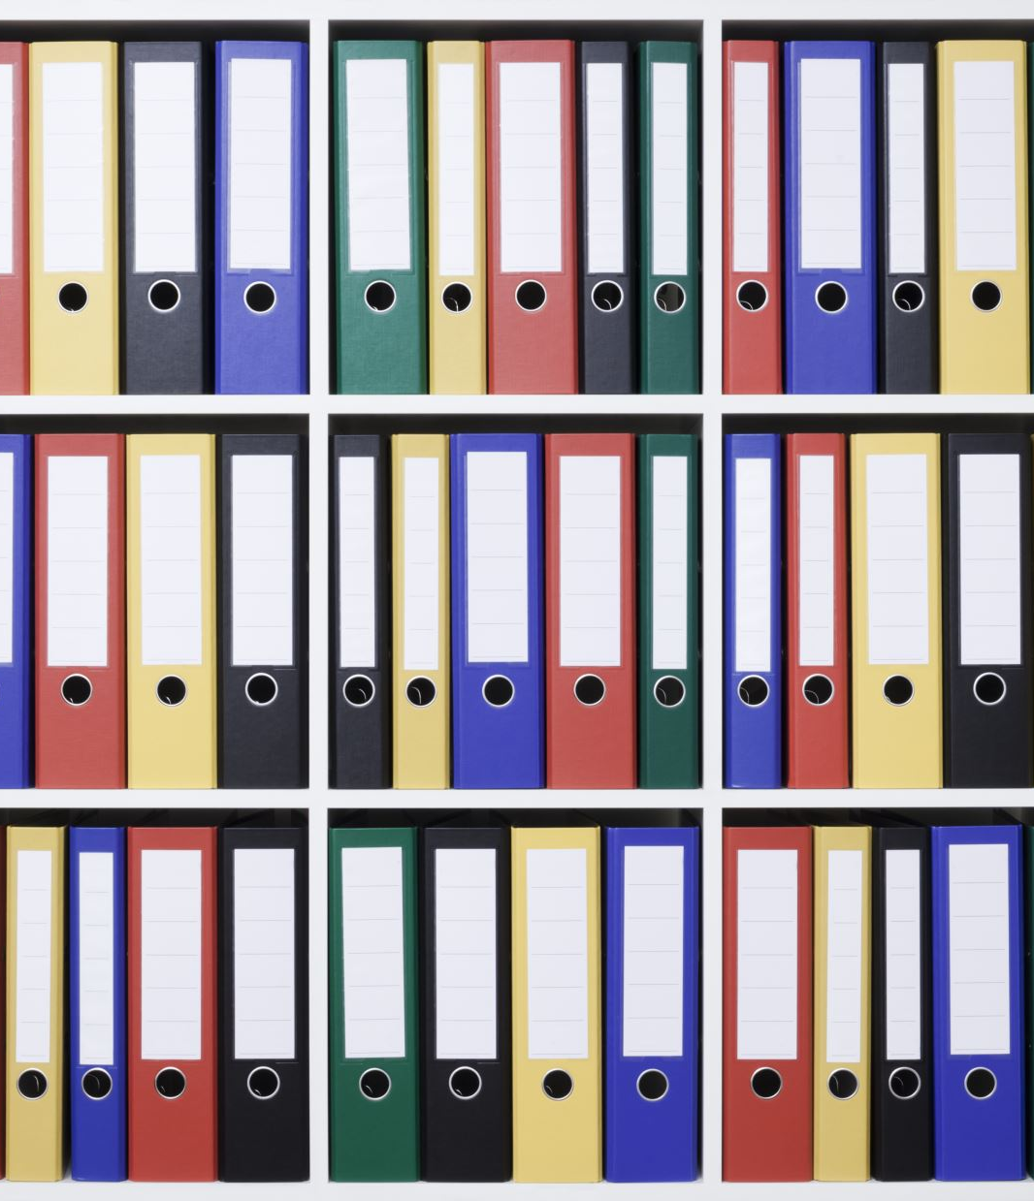
Binder Organization 101
EDUC 490 – Microteaching Lesson
Kieron Vick

Slide 2
Why Is Binder Organization Important?

Slide 3
Why Is Binder Organization Important?
Helps develop organizational skills and routines
Reduces the chance of losing schoolwork or school supplies
Always keeps you prepared for transitioning between classes
Improves time management
Reduces stress

Slide 4
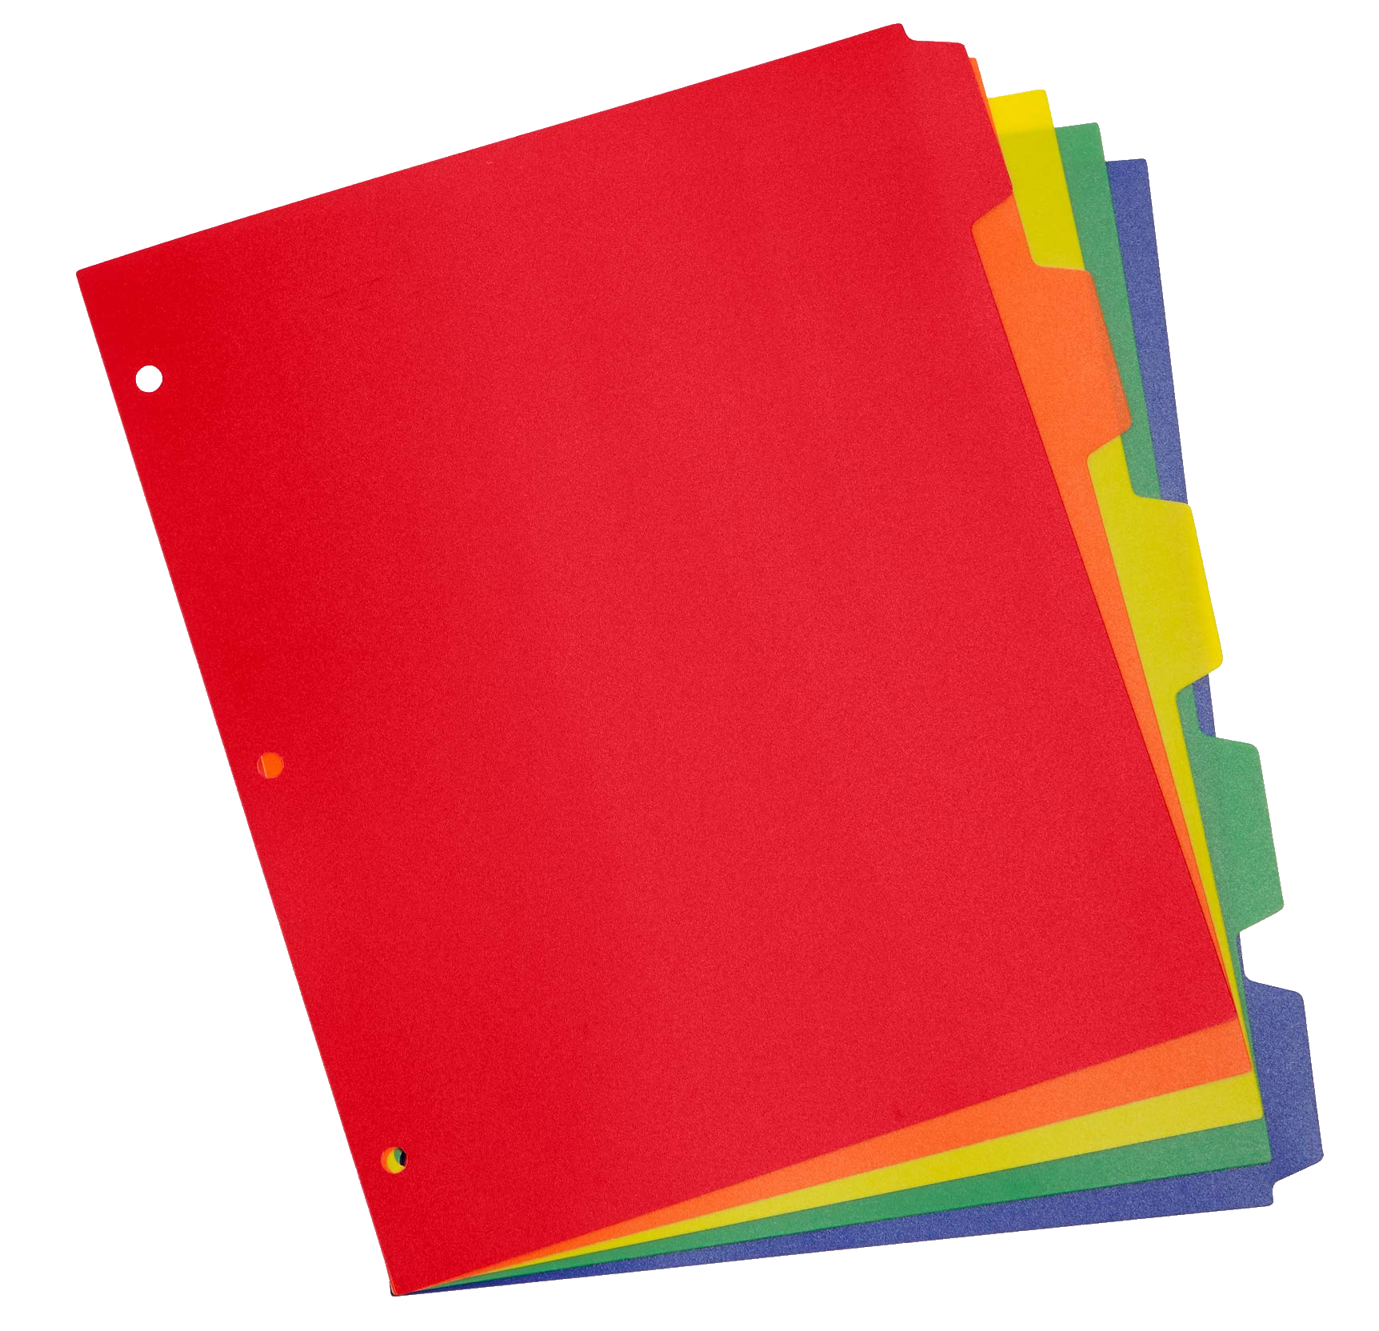
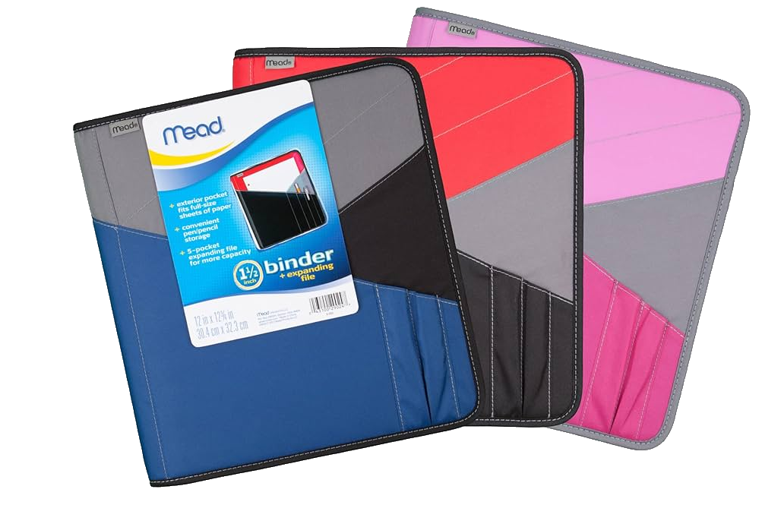
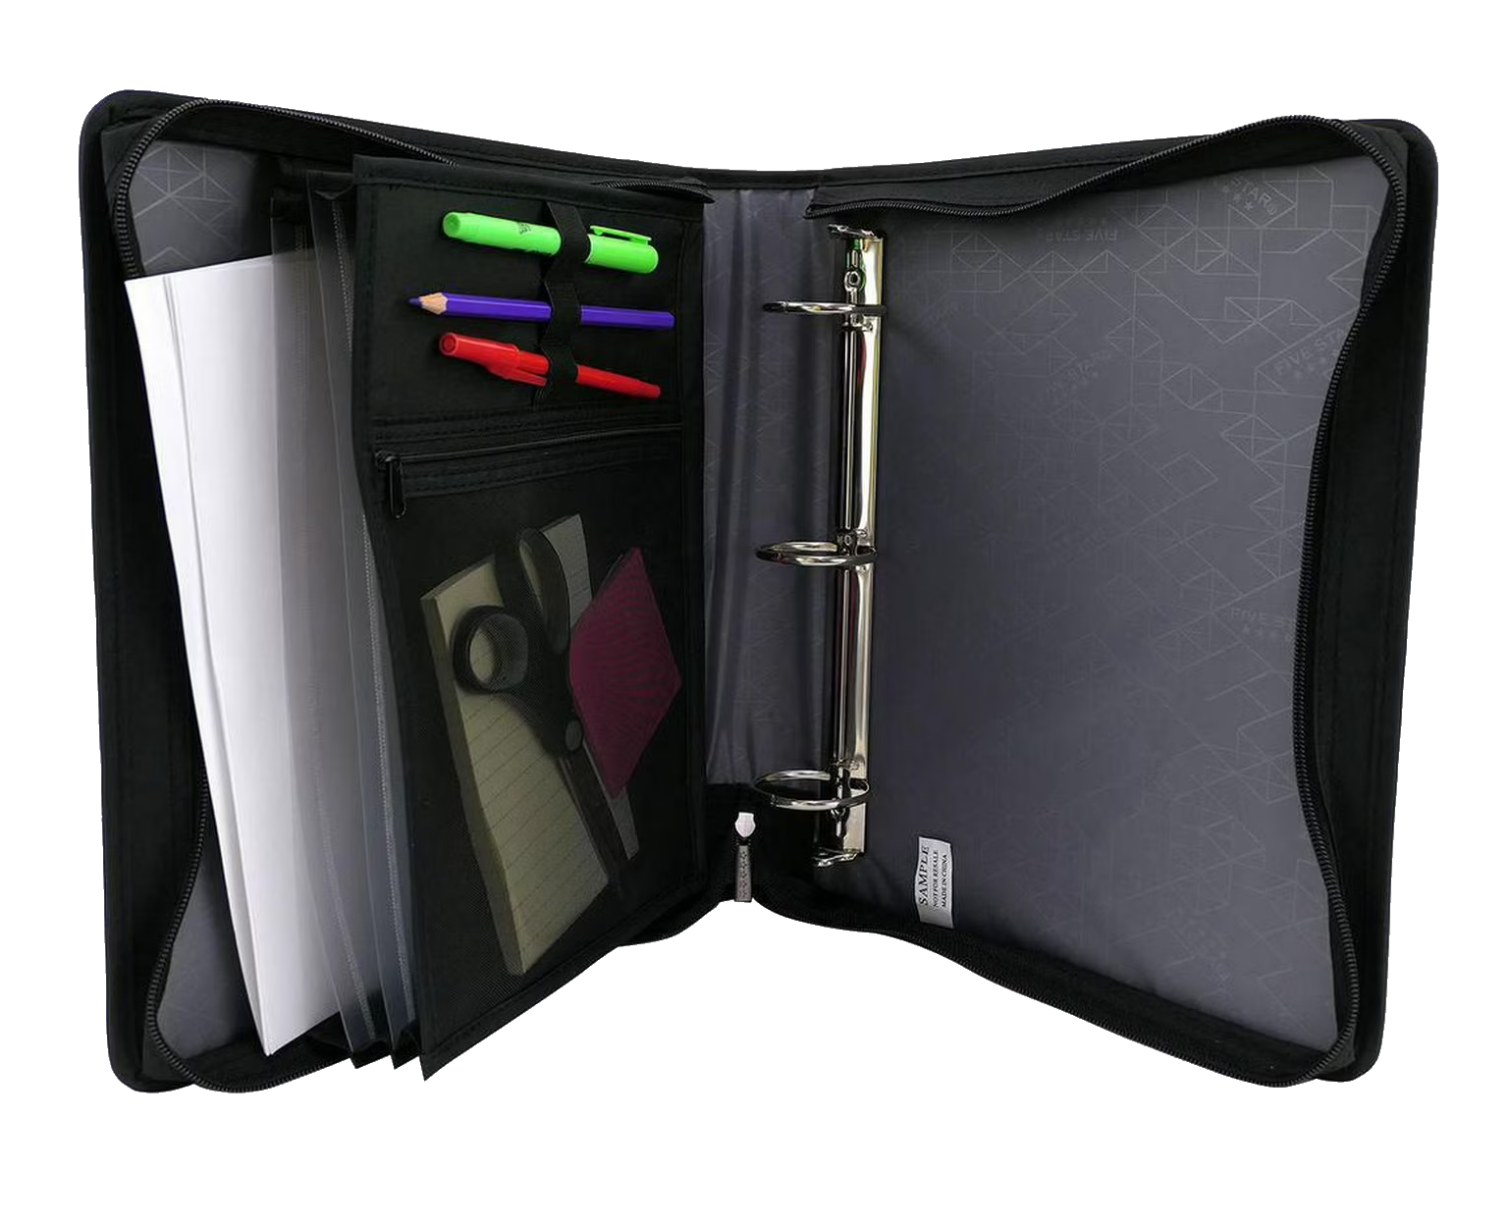
How to Properly Organize a Binder!
Recommended Binder:
Any zippered binder that is durable, capable of holding a lot of paper, and has compartments for school supplies.
Binder brands like Five Star or Mead are common, cheap, and reliable.
Binder Dividers:
Dividers that separate different subjects in your binder, which are essential for keeping your schoolwork organized and accessible.
- Colour coded dividers are most recommended, as they help visually with organization and helps identify different subject quickly. (Example: the green divider in your binder represents Science)

Slide 5
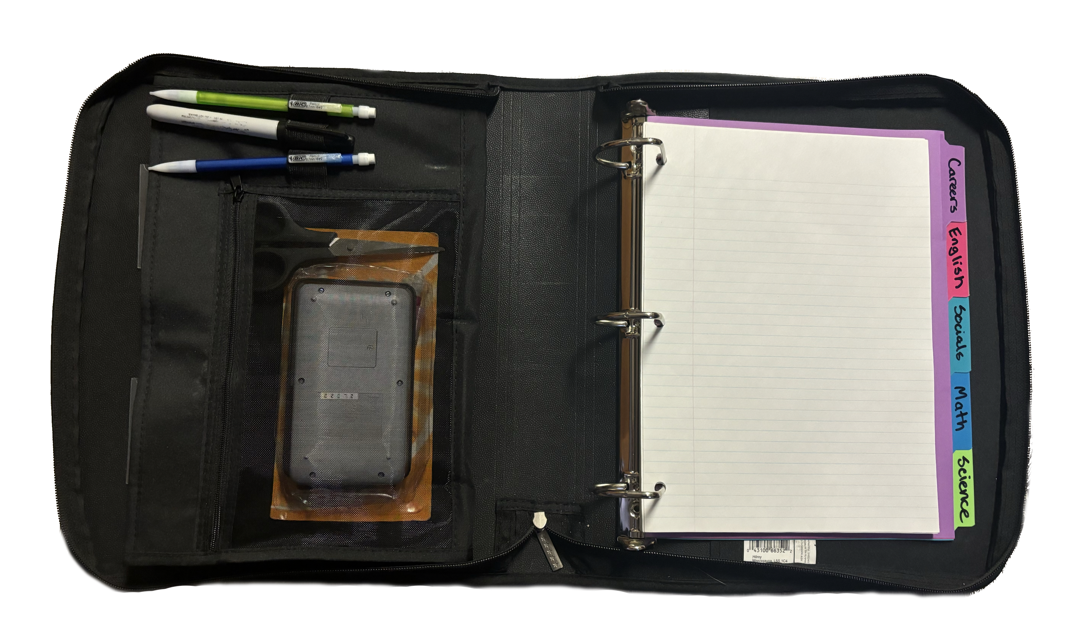
Finished Result!

Slide 6
In Conclusion…
Getting in the habit of organization, not just your binder but in other areas of school and your personal life is vital for being more productive, successful, and maintaining your well-being.
The emphasis of keeping your binder(s) organized will be heavier as your progress from grade 7 to grade 12, so try to build these organizational habits so they become automatic and apart of your routine.
There will be binder checks occasionally throughout the school year, so the expectation will be that you are keeping a nice and tidy binder!

