Slide 1
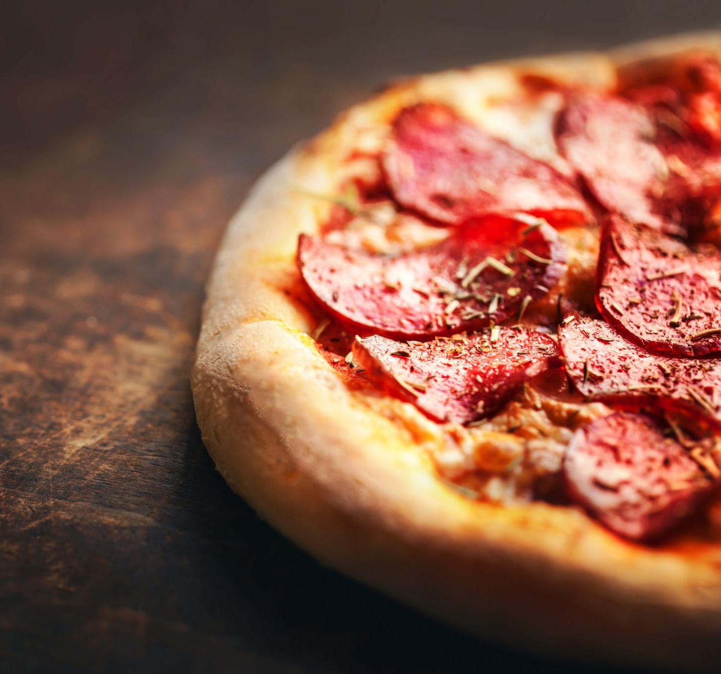
Pizza Toppings In French Garnitures de pizza en français

Slide 2
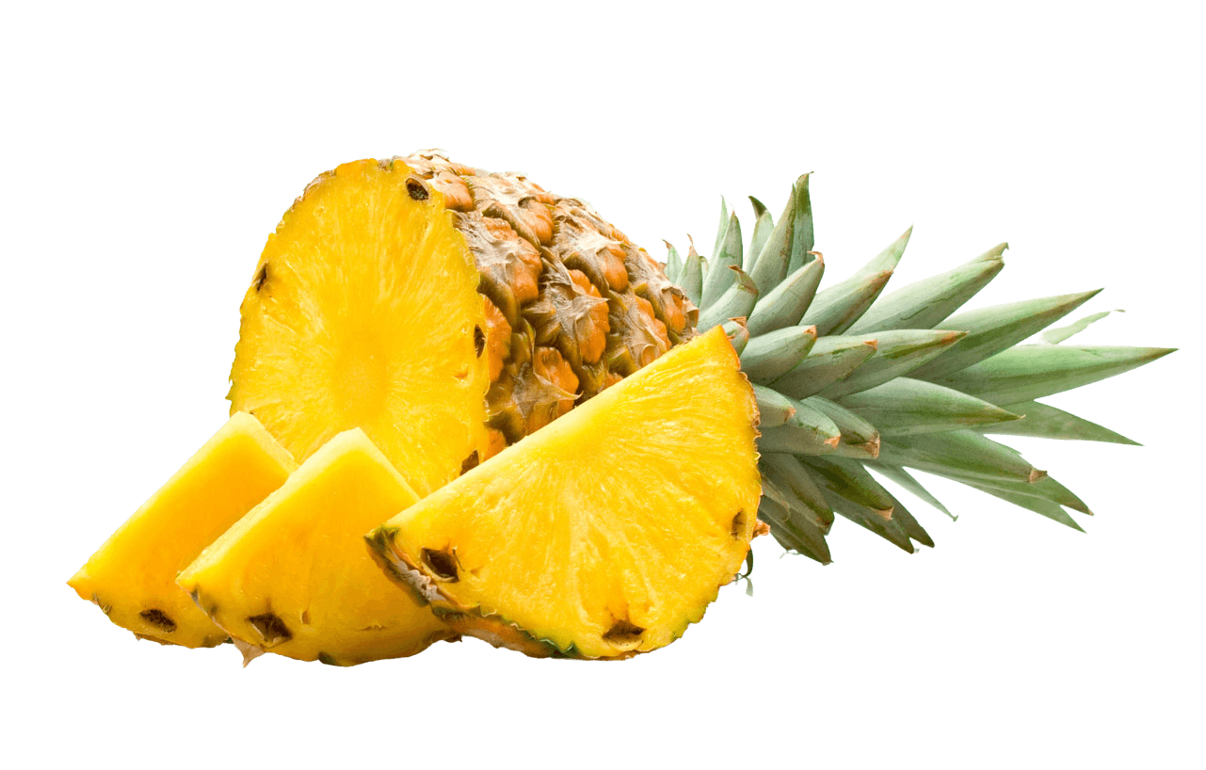
ananas

Slide 3
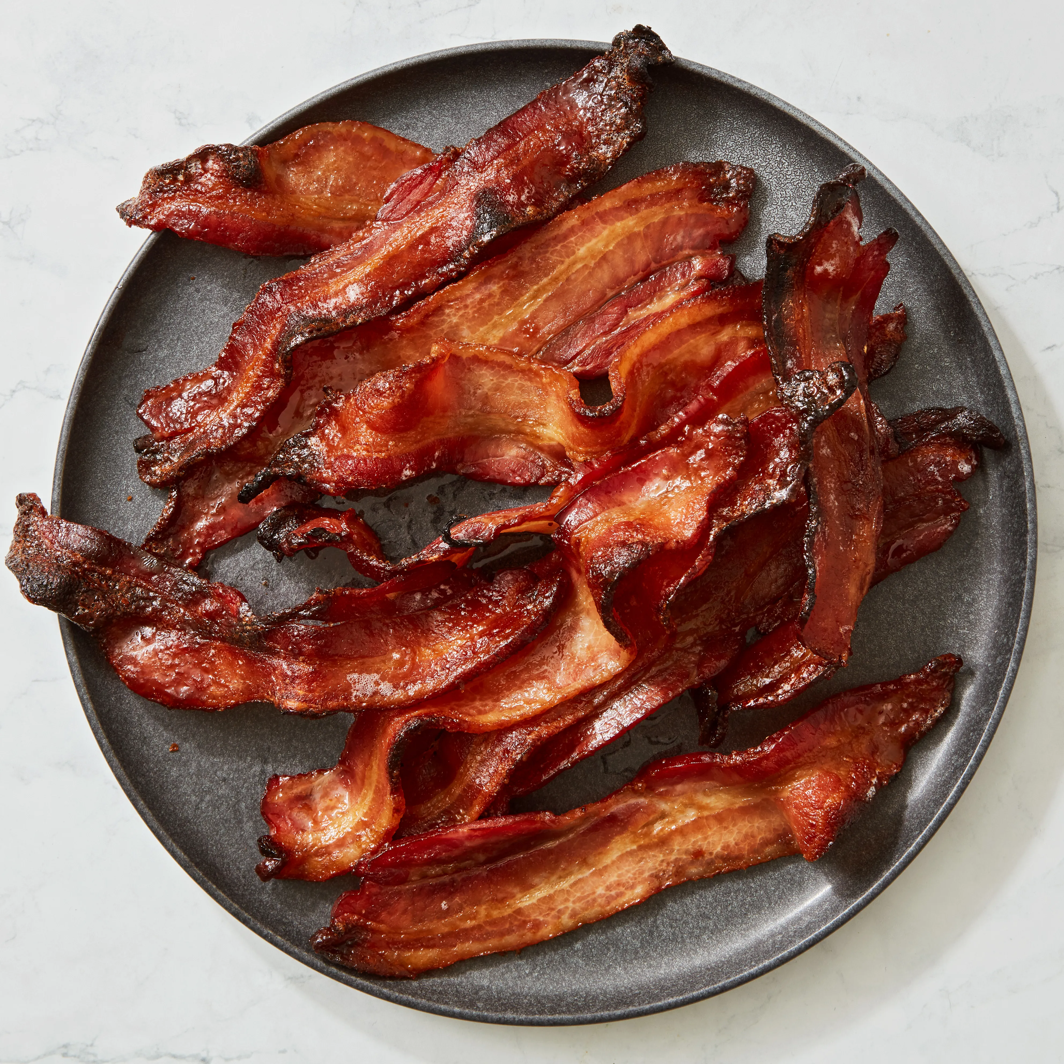
le bacon

Slide 4
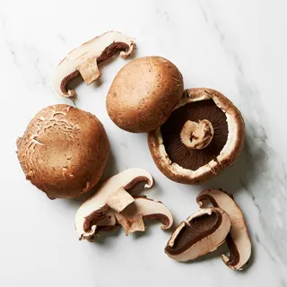
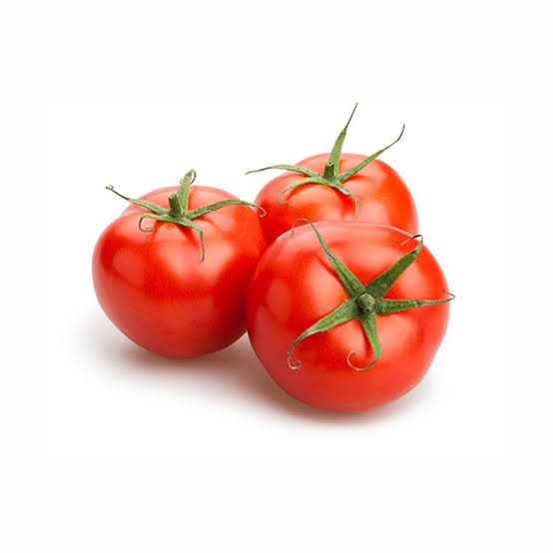
champignons

Slide 5
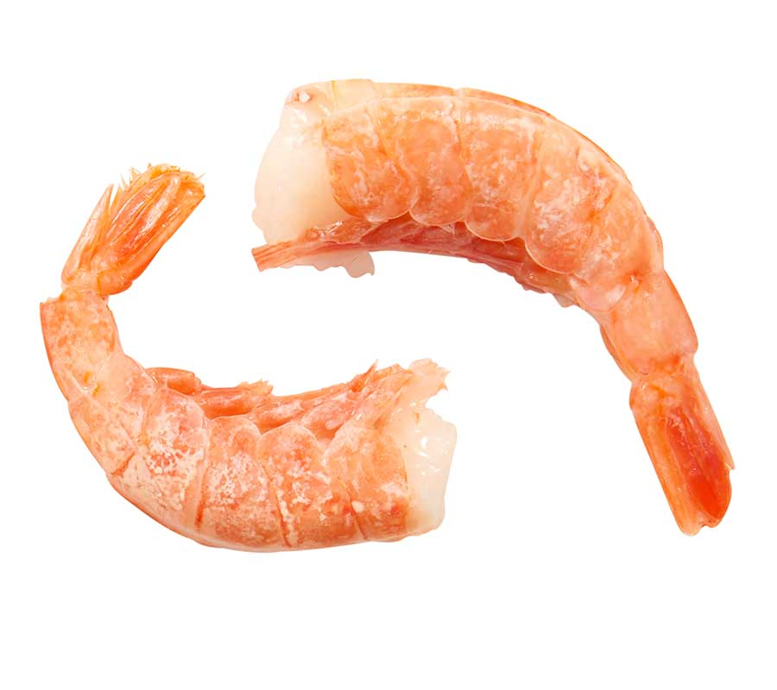
crevette

Slide 6
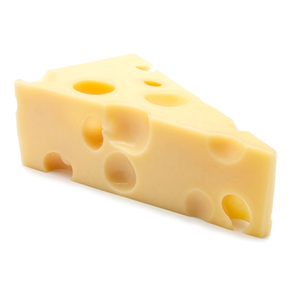
fromage

Slide 7
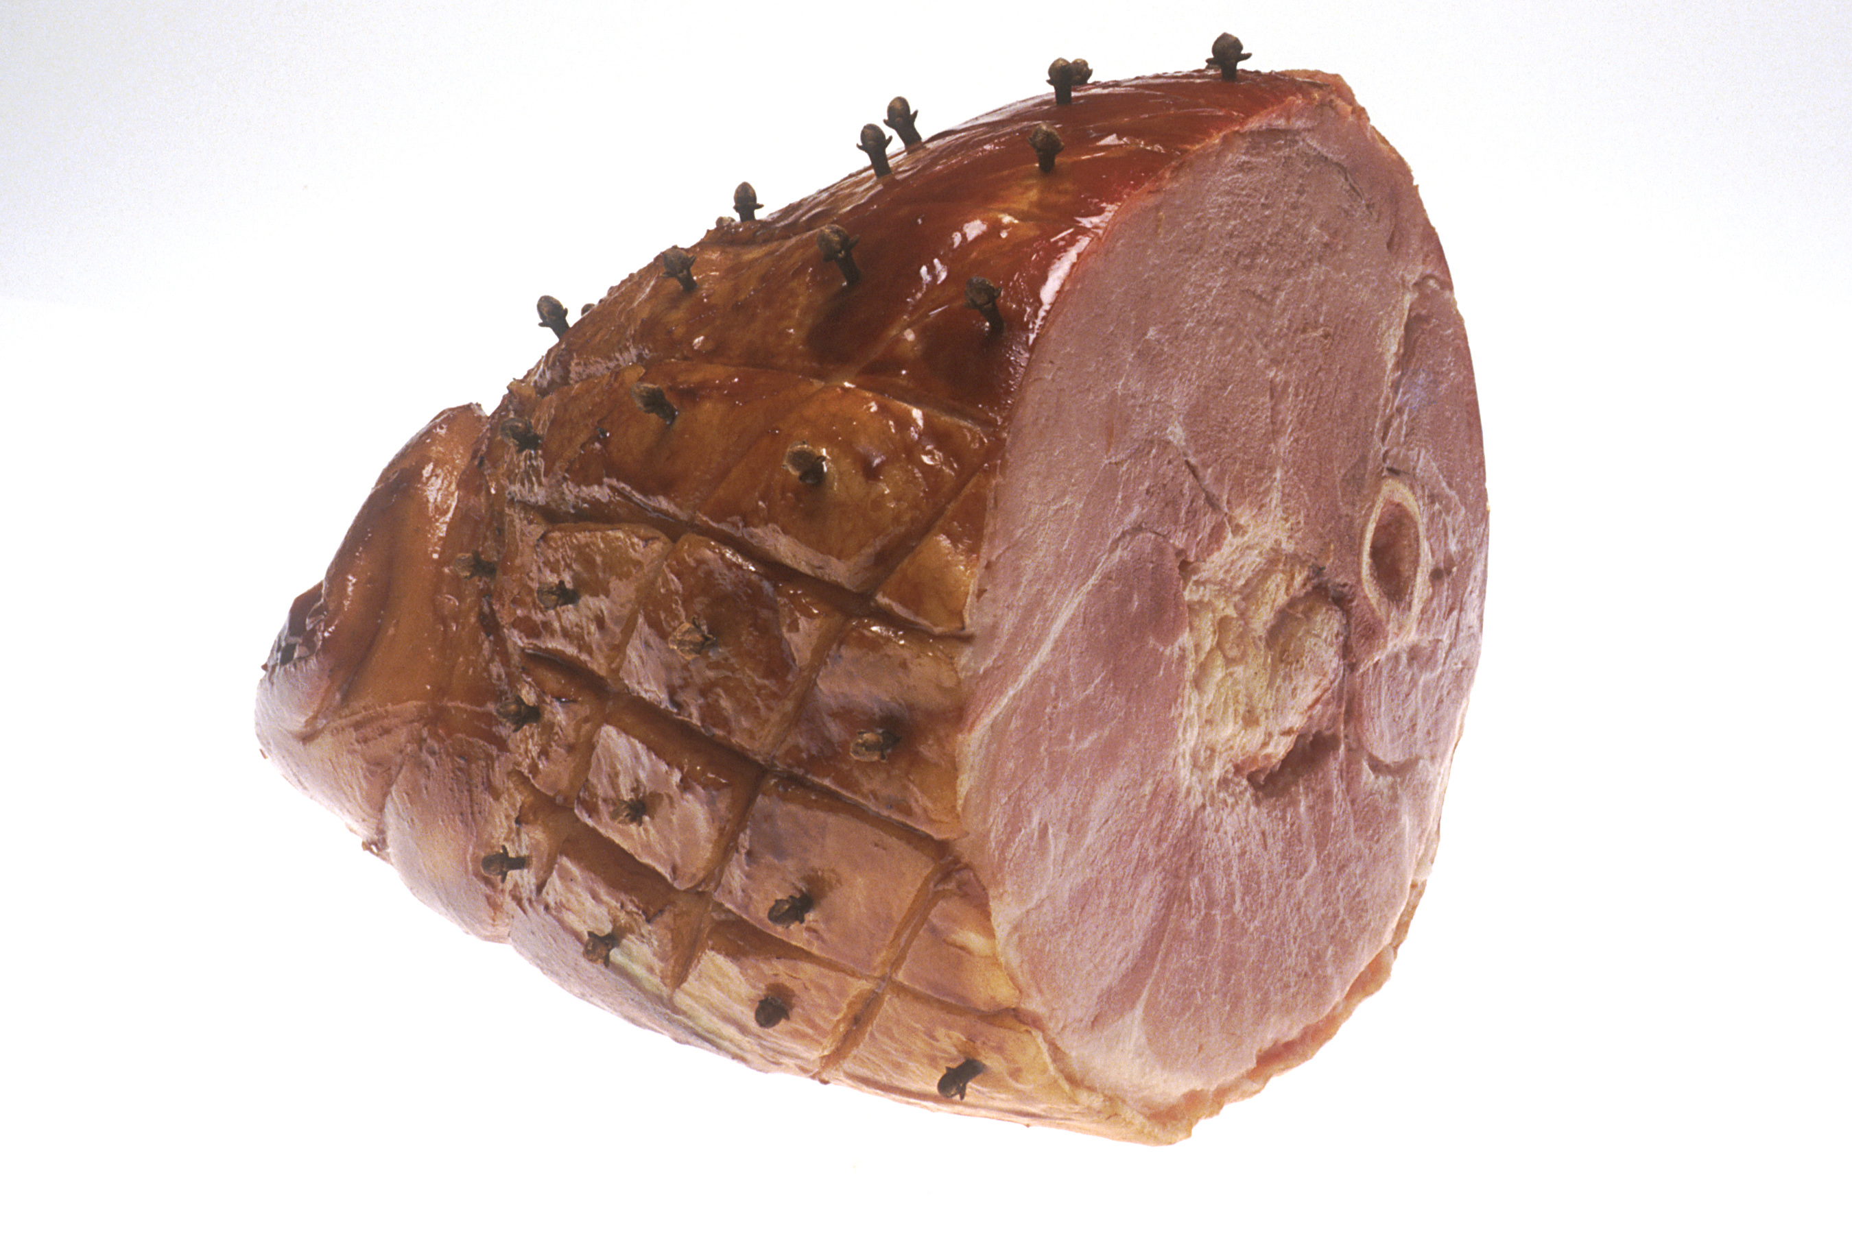
jambon

Slide 8
tomates

Slide 9
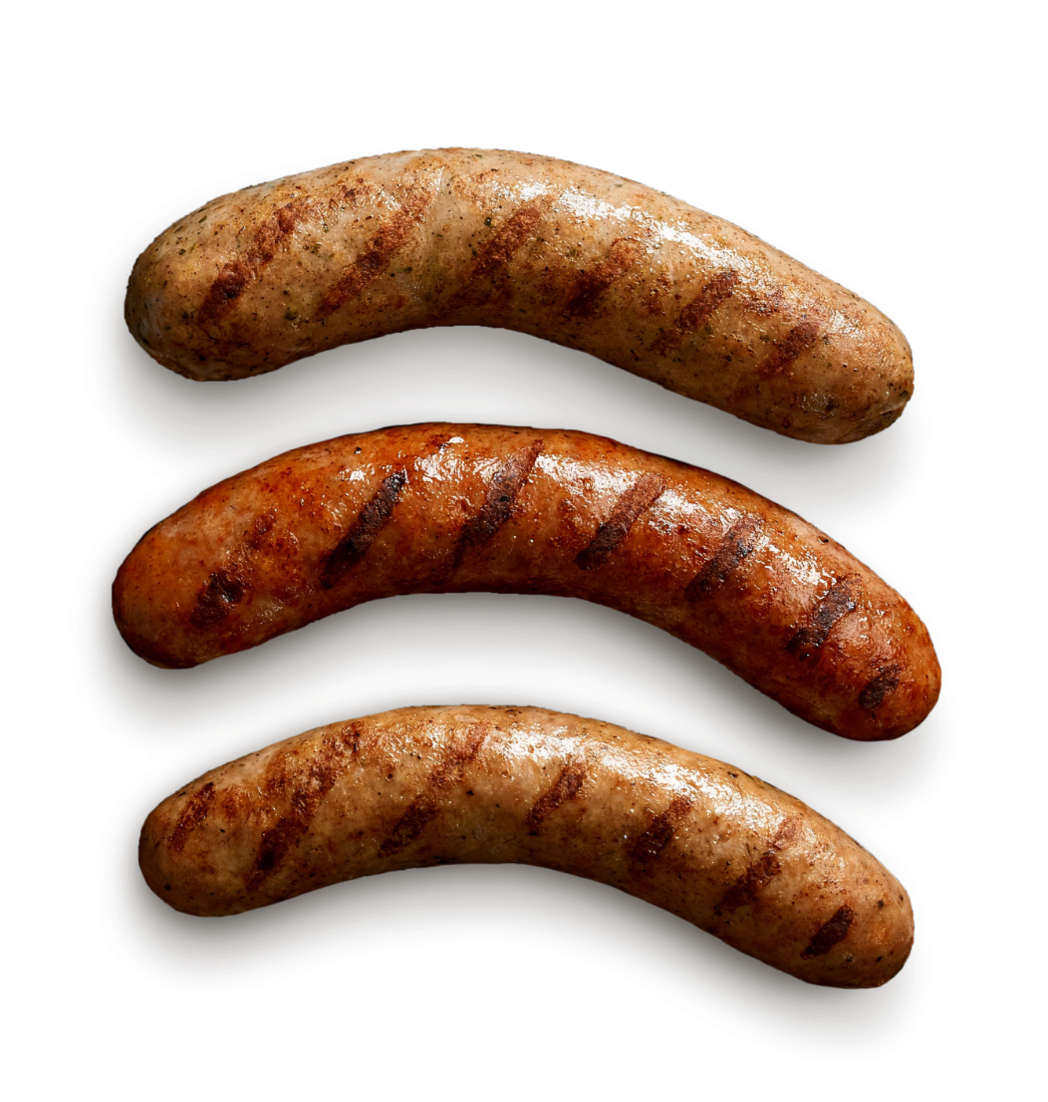
saucisse

Slide 10
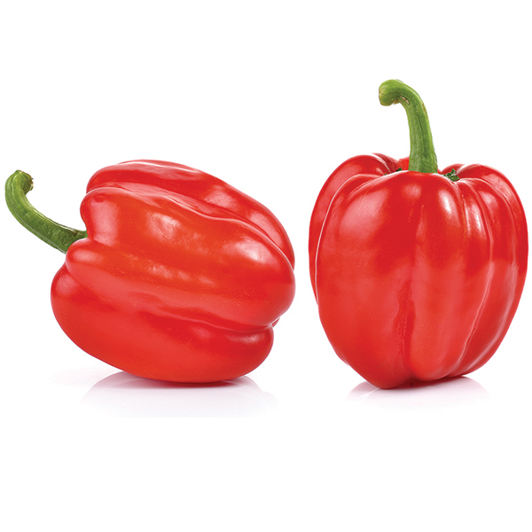
poivrons rouges

Slide 11
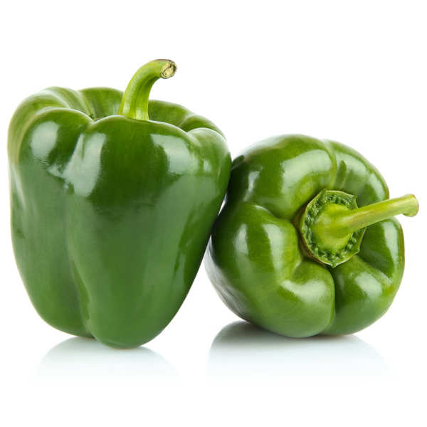
poivrons verts

Slide 12
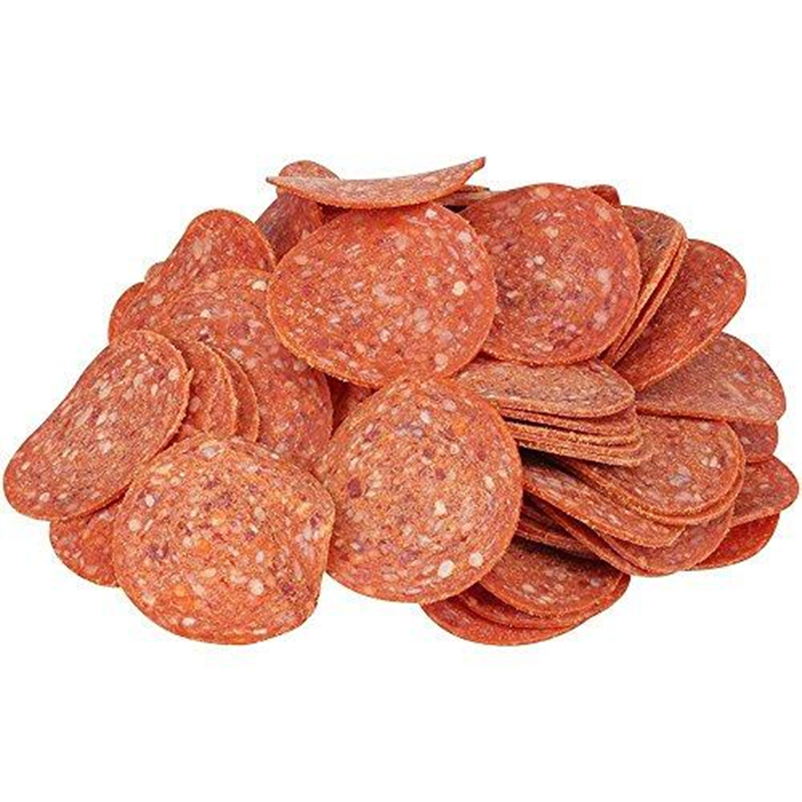
pepperoni

Slide 13
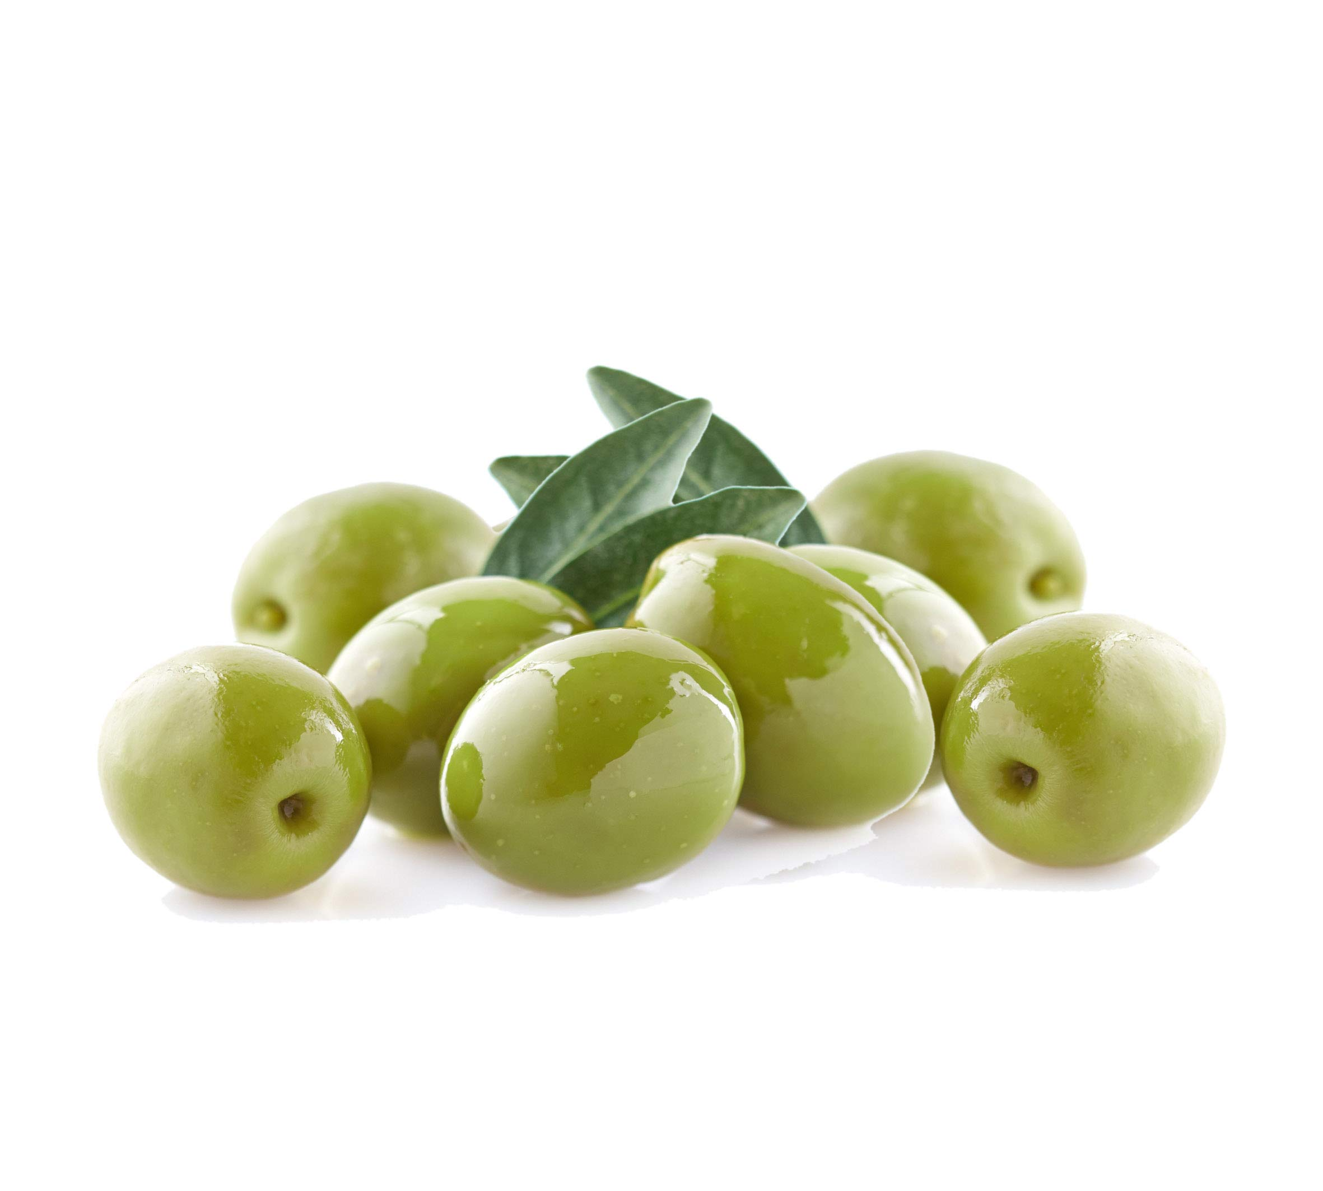
olives vertes

Slide 14
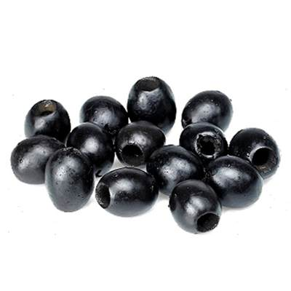
olives noires

Slide 15
pepperoni

Slide 16
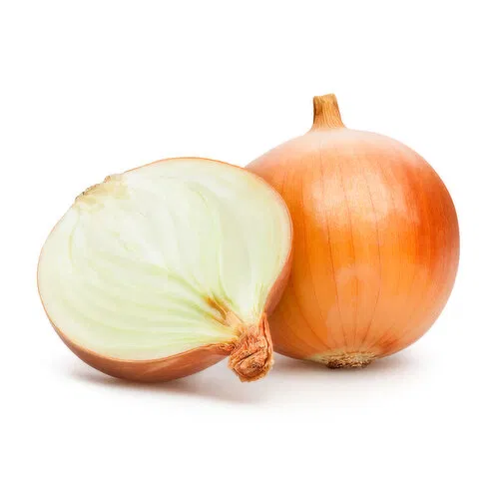
oignons

Slide 17
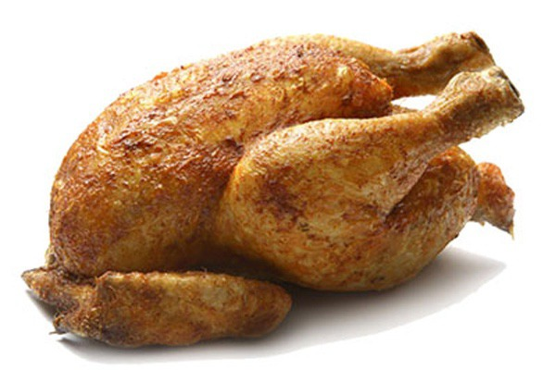
poulet

Slide 18
French Expressions: I like / I dislike
Je = I
J’aime = I like
je n'aime pas = I don’t like
Example:
Sur ma pizza, j’aime le fromage
Sur ma pizza, j'aime pas les olives vertes

Slide 19
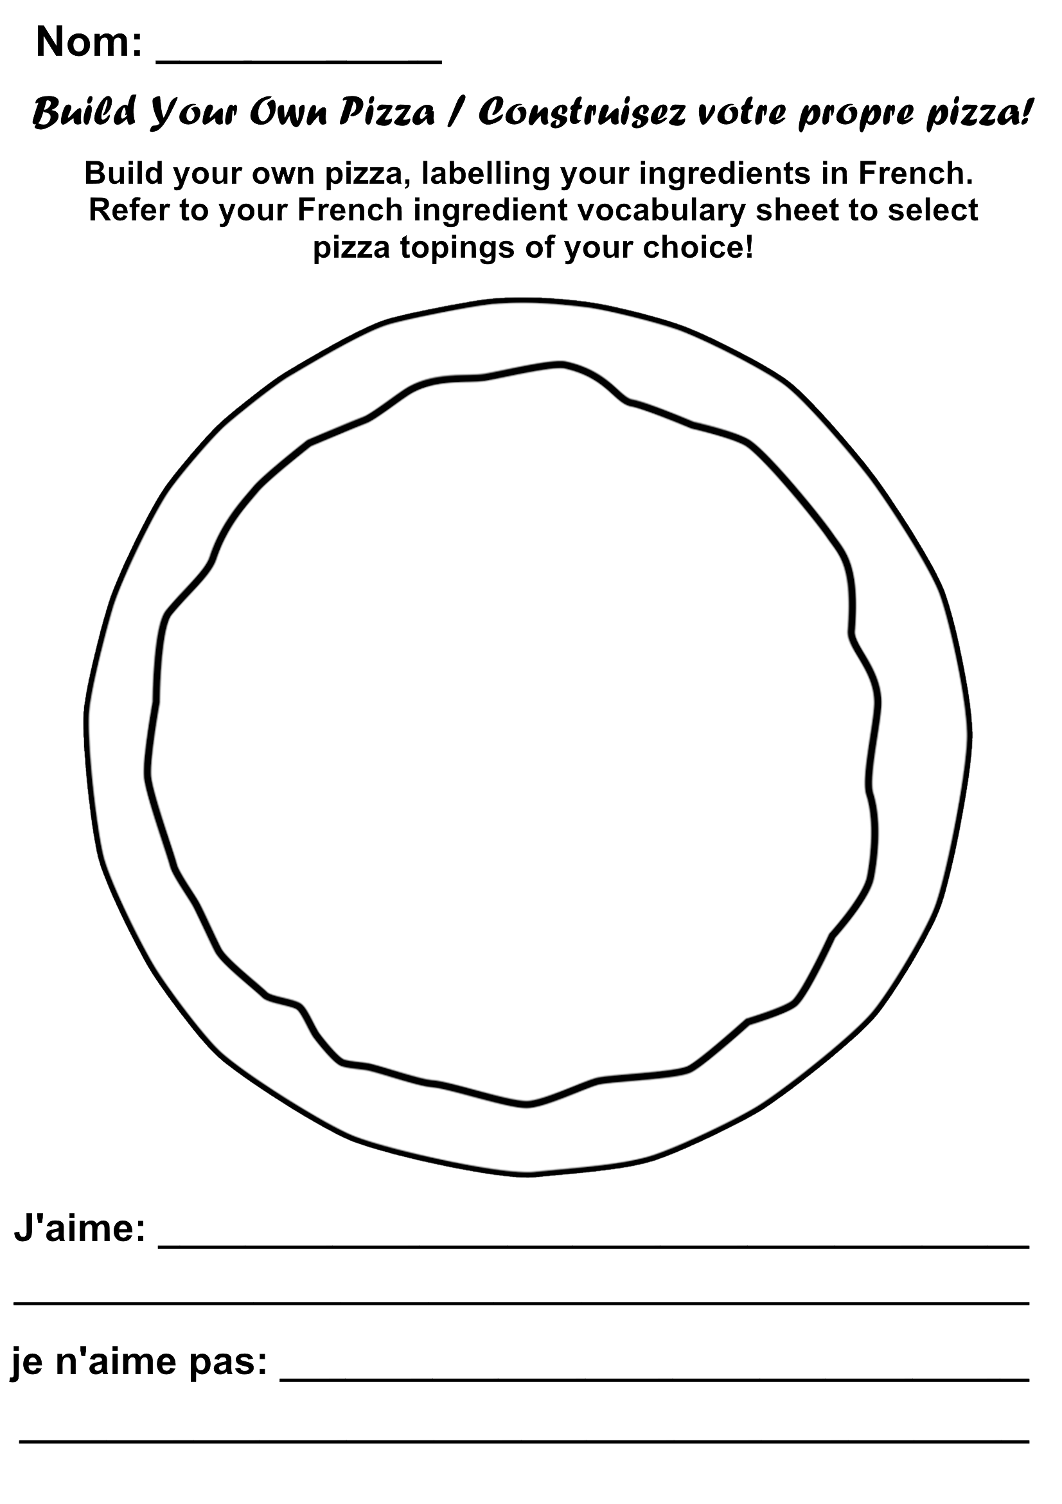
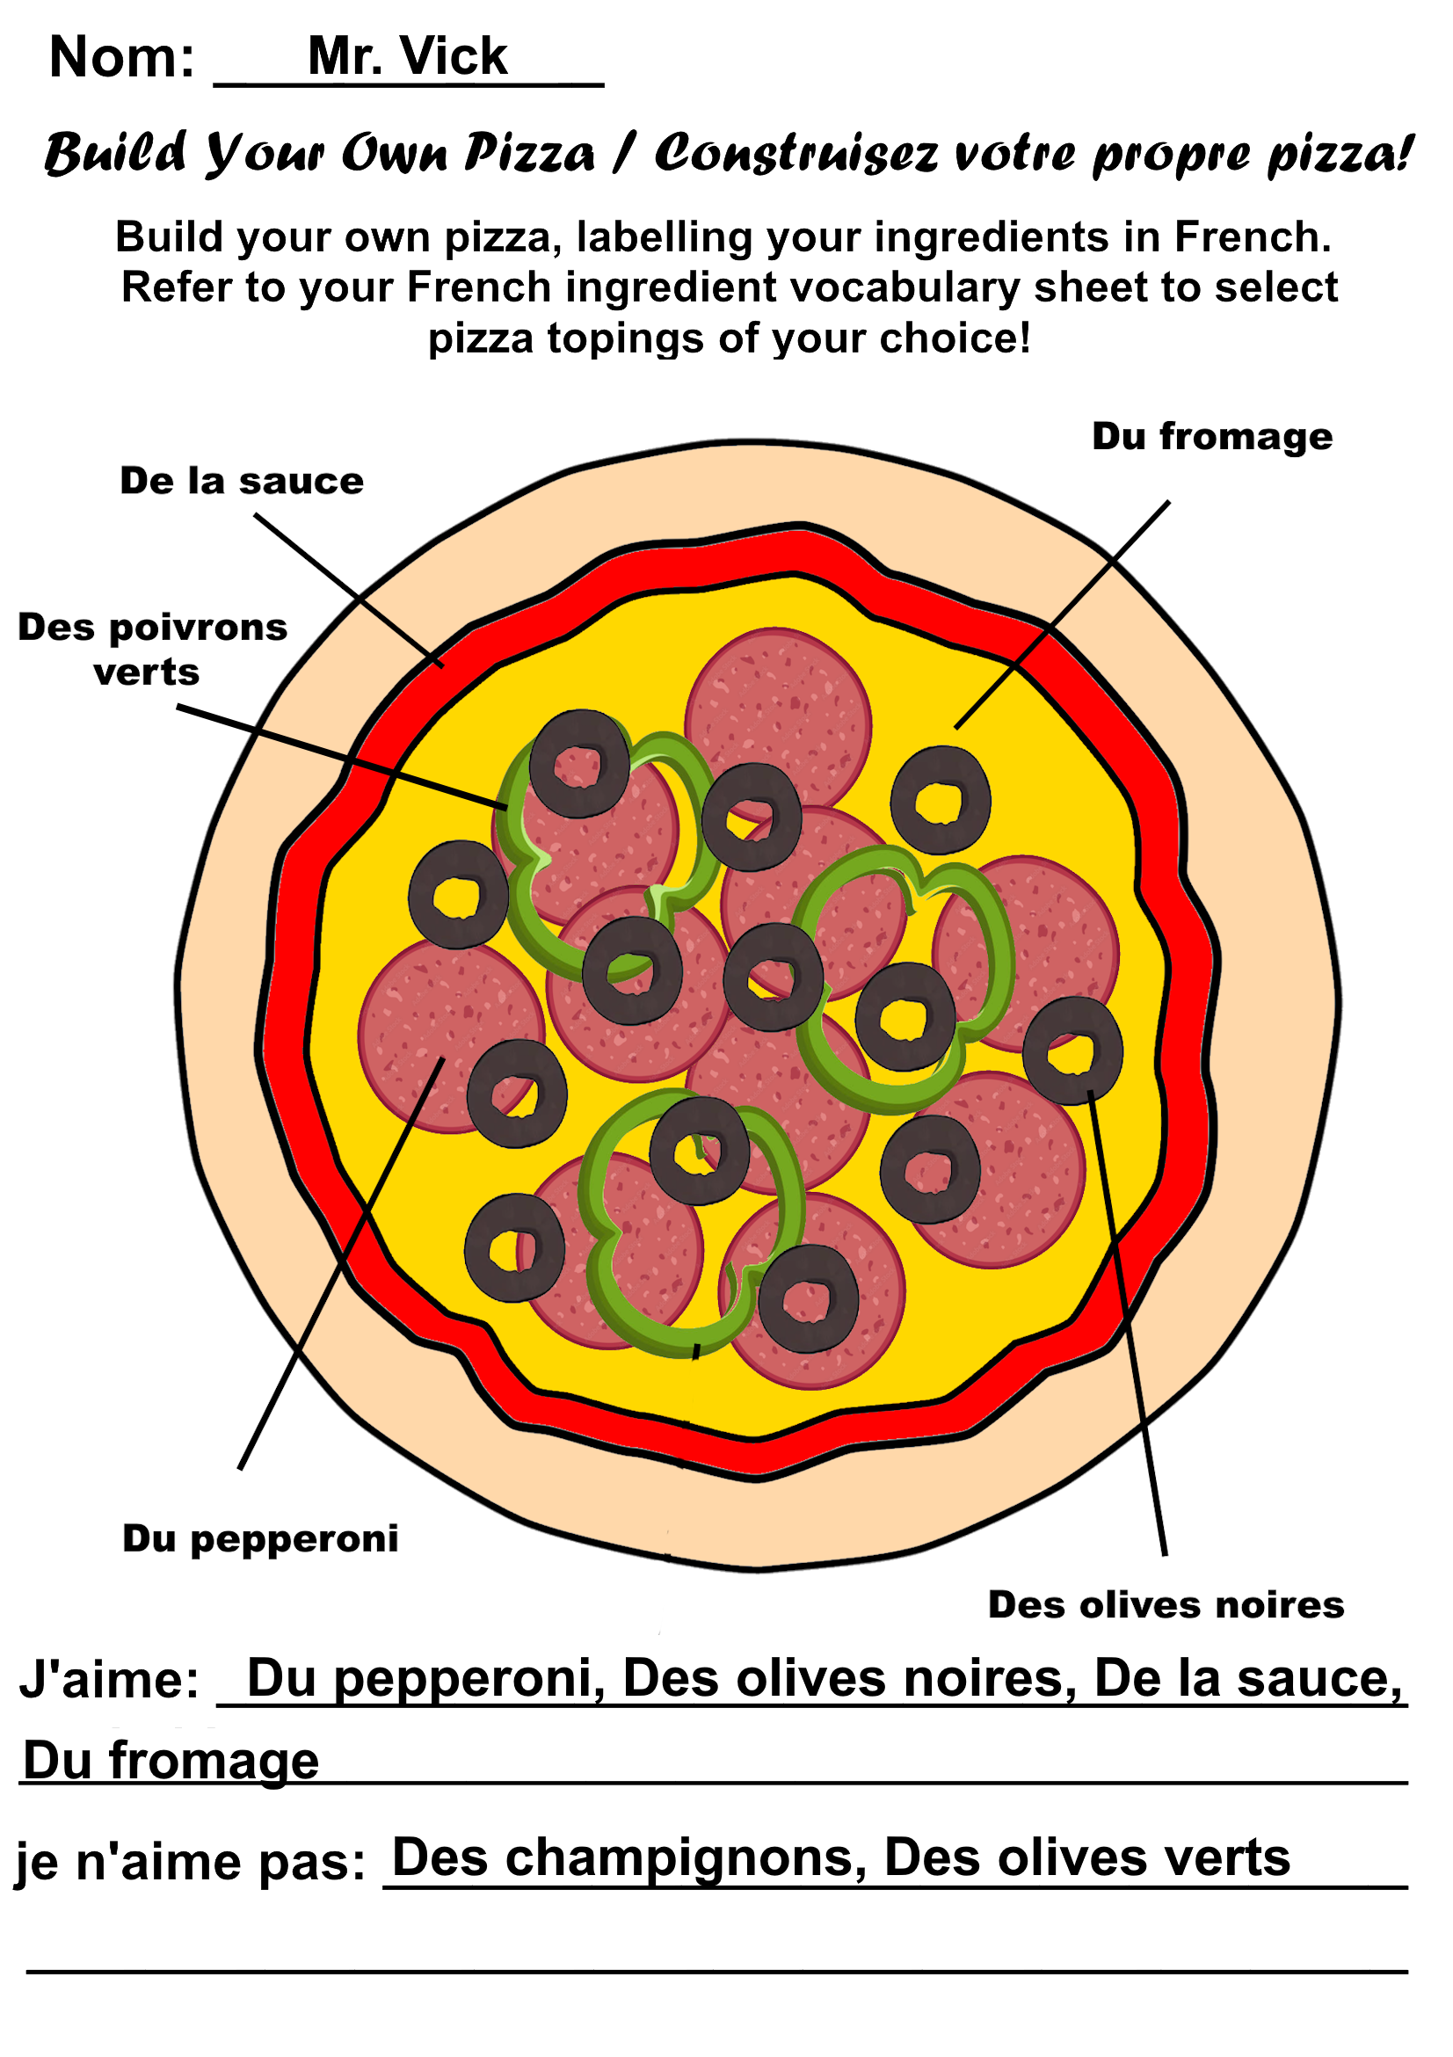
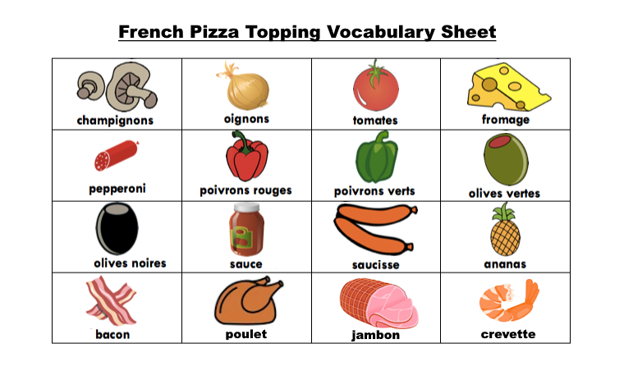
Design Your Own Pizzas!
Design your own custom pizza, labelling the toppings in French. Be sure to list the toppings you like and dislike!

